Slide 1
Ȯr_dungeons_of_oll-phiest
Interface design
By Jack C. Gallagher

Slide 2
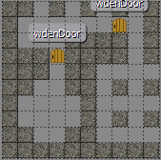
Level 1 – upper caves
Health bar
Name
Score/gold

